Slide 1
Software Requirement Specification
Course: Software Requirement Engineering
Course Teacher: MOHAMMAD SAMAWAT ULLAH
Group Members
Name | ID
MD SAKIB HOSSAIN | 20-42640-1
MD. RIAZ KHAN | 19-40183-1
MAHEZABIN SHEELA | 20-42810-1
SADIA LUBNA PROVA | 19-39949-1
MARZIA MEHZABEEN | 19-39594-1

Slide 2
Outline
Introduction
Overall Description
External Interface Requirements
System Features
Other Non-functional Requirements

Slide 3
Introduction
Purpose
We want to establish a system that can allocate parking space all over Dhaka and the customers parks their cars in that space. Our project will provide much-needed relief for this city and its people from the lack of parking spaces.
Document conventions
Document Conventions is an optional part where we explain the formats used in the document. What are bold words for, what is italic used for and so on.

Slide 4
Introduction
Intended Audience and Reading Suggestions
Describe the different types of reader that the document is intended for, such as developers, project managers, marketing staff, users, testers, and documentation writers.
Product Scope
We aim to provide a Parking solution. We will have two types of users one is Driver and another one is Renter. Parking charges will be estimated by our system. The payments will be done by Mobile banking. Ex: Bkash, Rocket, Nagad, and others.

Slide 5
Overall Description
Product Perspective
Our project will provide much-needed relief for this city and its people from the lack of parking spaces. We will have two types of users one is Driver and another one is Renter. The smart parking system using parking space recognition, mobile Internet, and other technologies applied to the parking lot.

Slide 6
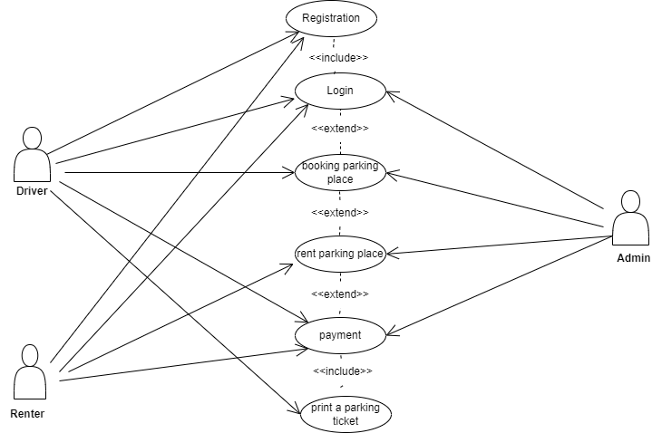
Overall Description
Diagram

Slide 7
Overall Description
User Classes and Characteristics
There are 3 classes in developing system: Driver, Renter and admin. Our 2 main class- Driver and Renter, they give full information about his/her such as name, surname, Id, address, phone. So different users will never be mixed in tables and they can be initialized by all these characteristics. Another class is admin. They controlled the full management system.
Operating Environment
The developed application will run on android and iOS platforms.

Slide 8
Overall Description
Design and Implementation Constraints
Design constraints are those constraints that are imposed on the design solution. These constraints are typically imposed by the customer, by the development organization, or by external regulations. Implementation constraints control placement and routing.
User Documentation
User Documentation is a the part in which you describe how you're going to distribute your documentation to your customer and product users.

Slide 9
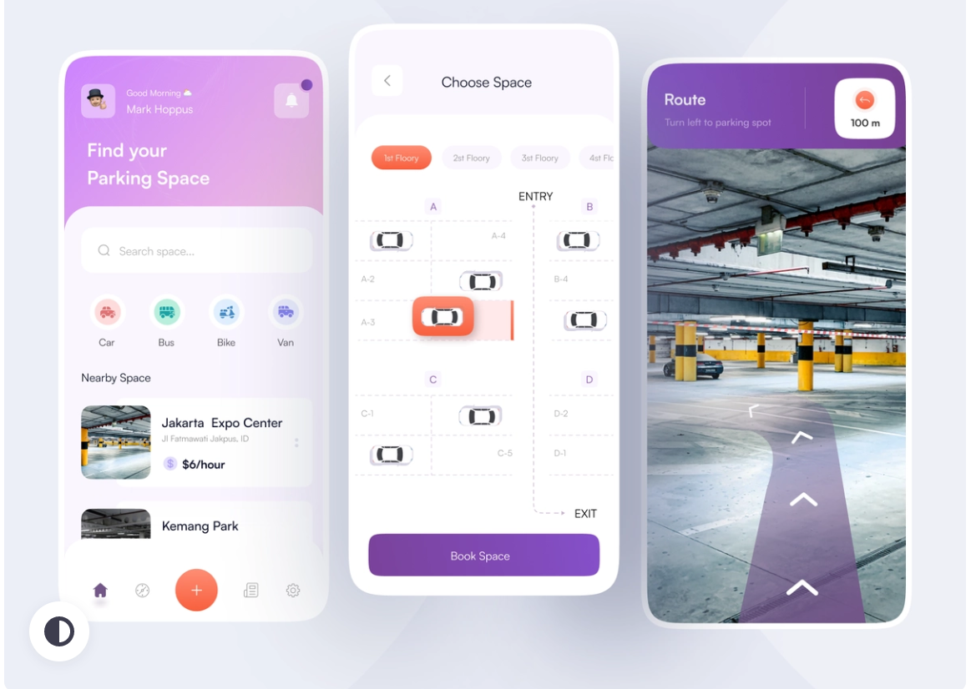
External Interface Requirement
User Interfaces
Describes the logical characteristics of each interface between the software product and its users.

Slide 10
External Interface Requirement
Hardware Interfaces
In Smart Car parking system app, will have certain requirements for the hardware interface, such as mobile device models and app versions, etc. Also, servers and mainframes This app will work on both iOS and Android devices.
Software Interfaces
This app's software interface will make use of Google Maps to locate a parking space, GPS to get there, mobile banking to process payments, trackers to monitor cars to determine whether or not users were successful in using the location, a software management system to oversee the app, among other things.

Slide 11
System Features
They included such items as:
Reliability.
Availability.
Serviceability.
Security.
Scalability.
maintainability.
Unlike the functional requirements (which are usually narrative in form), the system qualities usually consist of tables of specific metrics that the system must meet to be accepted.

Slide 12
System Features

Slide 13
Other Non-Functional Requirement
Performance Requirements
Performance requirements define how well the software system accomplishes certain functions under specific conditions. Examples include the software's speed of response, throughput, execution time and storage capacity. The service levels comprising performance requirements are often based on supporting end-user tasks.
Safety Requirements
The safety requirements are those requirements that are defined for the purpose of risk reduction. Like any other requirements, they may at first be specified at a high level, for example, simply as the need for the reduction of a given risk.

Slide 14
Other Non-Functional Requirement
Security Requirements
The security requirements cover areas such as:
Authentication and password management.
Authorization and role management.
Audit logging and analysis.
Network and data security.
Code integrity and validation testing.
Cryptography and key management.
Data validation and sanitization.

Slide 15
Other Non-Functional Requirement
Software Quality Attributes
Software Quality Attributes are features that facilitate the measurement of performance of a software product by Software Testing professionals, and include attributes such as
availability, Interoperability, correctness, reliability, learnability, robustness, maintainability, readability, extensibility, testability

Slide 16
Other Non-Functional Requirement
Business Rules
Business rules are a set of instructions that determine how a process is performed.
They guide decision-making by establishing rules that everyone must follow when carrying out certain activities.
Companies frequently apply business rules to approvals.
As an example, consider the loan application process.

Slide 17
Thank You

